Slide 1
Gardener’s Exchange
By: Chris Arpin, Brandon George, Adam Hursey, Noah Lindsey, Tim Ours, and Mitch Whedon
Notes:
Introduce ourselves, Adam

Slide 2
Business Proposal
Notes:
Adam

Slide 3
Motivation
Most people buy from local stores
Connected, local communities through gardening
Improved health, less waste
More interest in gardening
Notes:
Adam

Slide 4
Non-Customer Stakeholders
Sellers
Post listings
Accept/decline Trade offers
Buyers
Buy from listings
Offer trades to sellers
Notes:
Brandon

Slide 5
KT Situation Appraisal
List Concerns | Clarify Concerns | Severity | Urgency | Growth
Mindset | - Their mindset of income might hurt the start - The location of Upland would be harder to start an app than a larger setting | High - Still early, but with could affect the way that the app brings in revenue | Low - we haven’t started | Low - their minds are set on what they want
Encouraging for other to grow crops | - This is not currently the focus of the application - User interaction and user experience would be what would guide this encouragement | Medium - If the app doesn't launch well, it won’t grow | Low - again, we haven’t started, but also we don’t have much influence over potential crop growers | Low - this is early and something that would be added on later
Loss of buyer interaction | - Customers are what the application needs to grow and produce profit | High - Once there is a connection between the buyer and the seller they won’t require the app | High - This is an obstacle for the app growing initially | Low - This is a static issues
Notes:
Tim
Three concerns:
Mindset of making money
Injures initial growth
Not pressing
No focus on encouragement (Biggest selling point)
Biggest selling point to overcome initial growth problem
Only needs to be used to initialize relations
Biggest obstacle to continued growth

Slide 6
Solution Alternatives
Notes:
Noah

Slide 7
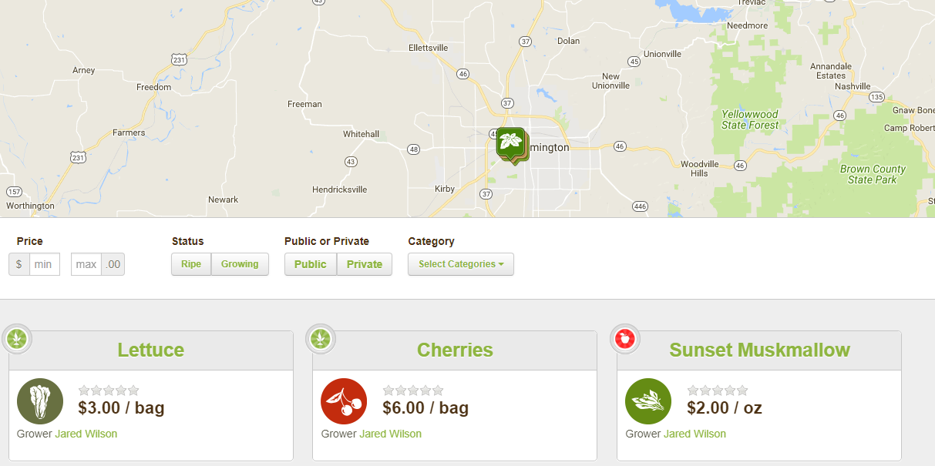
RipeNear.Me
Web application for buying/selling home-grown foods online
“Growing” and “Ripe” statuses
“Friend” other users
Interactive map area
Notes:
Noah

Slide 8
Budget/Cost-Benefit Analysis
Free to use
NPV = $0
No income from a charge per transaction
Notes:
Mitch

Slide 9
The Farmer’s Garden
Web application for buying/selling/swapping home-grown foods
Requests foods, offer free items
Minimal clicks to get tasks done, easy to use
Notes:
Chris

Slide 10
Budget/Cost-Benefit Analysis
Free to use
NPV = $0
No income charge per transaction
Notes:
Mitch

Slide 11
Custom Build
Notes:
Tim

Slide 12
Gardener’s Exchange
Mobile application for buying/selling/trading home-grown foods
Home Feed of listings in a default search radius
Card listing style
Easy to use interface
Notes:
Tim
Used to buy, sell, and trade home-grown produce or otherwise.
Simple, intuitive, and easy to use.

Slide 13
Budget/Cost-Benefit Analysis
Initial investment: $540 maintenance, $25 publishing on Google Play Store
$540 yearly maintenance cost
NPV > 0
Benefits based off of a small charge per transaction
Year | 0 | 1 | 2 | 3 | 4
Discount Rate | 4%
Costs
Initial Investment | -$565
Maintenance |  | -$540 | -$540 | -$540 | -$540
Benefits | $0.00 | $700.00 | $700.00 | $700.00 | $700.00
Future Value | -$565 | $160.00 | $160.00 | $160.00 | $160.00
Present Value | -$565 | $153.85 | $147.93 | $142.24 | $136.77
Cash Flow | -$565 | -$411.15 | -$263.22 | -$120.99 | $15.78
NPV | $15.78
Notes:
Mitch

Slide 14
KT Decision Analysis
Notes:
Brandon

Slide 15
 |  | Gardener’s Exchange |  |  | RipeNear.Me |  |  | The Farmer’s Garden
Musts |  | Comments |  | Y/N | Comments |  | Y/N | Comments |  | Y/N
User Posted Content |  |  |  | Y | Users post items |  | Y | Users post items |  | Y
User Buying and Selling |  |  |  | Y | Buying and selling from user |  | Y | Buying and selling from user |  | Y
Wants | Wgt | Comments | Score | Wgt’d Score | Comments | Score | Wgt’d Score | Comments | Score | Wgt’d Score
Offer and Accept Trades | 25% |  | 10 | 2.5 | No trading within the app | 0 | 0 | Yes, barter transaction | 10 | 2.5
Charge per transaction | 15% |  | 10 | 1.5 | No | 0 | 0 | No, the app is owned by someone else | 0 | 0
Stream is the home page | 15% |  | 10 | 1.5 | Yes Homepage is given after typing in the ZIP code | 8 | 1.2 | Yes, home page lists item for sale with default search parameters | 10 | 1.5
Search by Keyword | 15% |  | 10 | 1.5 | No, able to filter after ZIP search | 5 | 0.75 | Search by transaction type and category | 9 | 1.35
Filter between closeness and proximity | 15% |  | 10 | 1.5 | Search by ZIP code | 10 | 1.5 | Yes, ZIP and search radius | 10 | 1.5
Transaction History | 5% |  | 10 | .5 | No | 0 | 0 | No | 0 | 0
Buyer can look at items without setting up an account | 5% |  | 10 | .5 | Yes | 10 | .5 | No | 0 | 0
Simple layout according to material design standards | 5% |  | 10 | .5 | Yes | 10 | .5 | Simple and easy to use website | 9 | 0.45
Totals | 100 |  |  | 10 | Very well put together |  | 4.75 | Simple web app for finding other foods |  | 7.3
Notes:
Brandon

Slide 16
Our Recommendation
Notes:
Tim

Slide 17
We recommend the Gardener’s Exchange
Meets all requirements without sacrificing highly weighted wants
No development costs
Involvement through development
Notes:
Tim
Meets requirements
Special opportunity with no dev costs
Customers can be involved in dev

Slide 18
Software Requirements Specification
Notes:
Tim

Slide 19
User Roles
Users
Unregistered User/Guests
Customer
Seller
Notes:
Tim
Users
Unregistered User/Guests
Customer
Seller

Slide 20
Collaborating Systems/Software
PayPal Expresses Services
Amazon Web Services S3
Notes:
Brandon

Slide 21
Schedule
Date | Milestone
January 30th | Start product development
February 15th | Backend complete, app development begin
March 15th | External systems integrated
March 30th | Start testing
April 20th | Polish product
May 5th | Documentation and preparation for app release
May 17th | App released on App Store
Notes:
Noah

Slide 22
Functional System Requirements
Notes:
Adam

Slide 23
System Response Table
Notes:
Adam

Slide 24
Event ID | Source | Trigger | Response | Major Outputs | External Destinations
L1 | Guest | Enters the app | Shows a list of items within 25 miles | Home feed | None
L8 | User | Pressing the Distance Button | Pop up box where customer can edit the distance that the app looks for items | Changes searching distance to the set amount | None
C2 | Customer | Buys items | Adds an order to the database and notifies the seller | Order data, Email to seller, Home Feed | Project database, seller email
C4 | User | Views the details of a listing | Generates page with more information about the item | Item page | None
T1 | Customer | Offers Trade | Adds a trade to the database, notifies seller | Trade data, email to seller | Project database, seller email
T2 | Seller | Accepted Trade | Update trade data to close trade and email offering customer | Trade data, email to offering customer | Project database, offering customer email
S1 | Seller | Lists an item for sale | Adds new listing to database | Listing data | Project database
S4 | Seller | Clicks button to view trade offers | Sent to trade offers page | Trade offers page | None
Notes:
Adam + Brandon

Slide 25
Use Cases
Notes:
Chris

Slide 26
ID | L1
NAME | Enters the App
Primary Actor | Guest
Other Actors | None
Description | Guest enters app without a login
Actor Action |  |  | System Response
Typical Event Flow | Guest opens app on smartphone
 |  |  | 2. System opens app to the home feed
Alternate Event Flows | Guest opens app on smartphone
 |  |  | 2. System crashes on opening the app
Business Focus |  |  | System Focus
Before event | Trigger | Enters the App | Preconditions | App installed on smartphone
After event | Conclusion | Shows listing of items within 25 miles | Postconditions | Display the home feed
Notes:
Chris

Slide 27
ID | L8
NAME | Search by distance
Primary Actor | Guest
Other Actors | None
Description | User changes the distance parameter
Actor Action |  |  | System Response
Typical Event Flow | User presses the Distance button
 | 2. User enters a new distance
 |  |  | 3. System refreshes Home Feed with new listings
Business Focus |  |  | System Focus
Before event | Trigger | Pressing the Distance button | Preconditions | Application running
After event | Conclusion | Pop up box where user can edit the distance that the app looks for items | Postconditions | Home feed updated with new distance parameter
Notes:
Chris

Slide 28
ID | C2
NAME | Buying items
Primary Actor | Customer
Other Actors | None
Description | Customer buys the items
Actor Action |  |  | System Response
Typical Event Flow | Customer presses the Buy button
 |  |  | 2. System asks for confirmation
 | 3. Customer confirms buy order
 |  |  | 4. System create a new order entry in database
 |  |  | 5. System notifies seller of buy order
Alternate Event Flows | Customer presses the Buy button
 |  |  | 2. System asks for confirmation
 | 3. Customer cancels buy order
 |  |  | 4. System loads item details page
Business Focus |  |  | System Focus
Before event | Trigger | Buys items | Preconditions | Customer logged in
After event | Conclusion | Adds an order to the database and notifies the seller | Postconditions | New order entry in database
Notes:
Chris

Slide 29
ID | C4
NAME | View listing details
Primary Actor | Customer
Other Actors | None
Description | Customer views the details of a particular listing
Actor Action |  |  | System Response
Typical Event Flow | Customer presses on a listing
 |  |  | 2. System loads the item details
Business Focus |  |  | System Focus
Before event | Trigger | Views the details of a listing | Preconditions | Customer logged in
After event | Conclusion | Generates page with more information about the item | Postconditions | Item details displayed
Notes:
Chris

Slide 30
ID | T1
NAME | Offer a trade
Primary Actor | Customer
Other Actors | Seller
Description | Customer offers to trade their item for seller’s item
Actor Action |  |  | System Response
Typical Event Flow | Customer presses the Trade button
 | 2. Customer enters items to trade
 |  |  | 3. System confirms trade offer, adds trade entry to database
 |  |  | 4. System notifies seller of trade offer
Alternate Event Flows | Customer presses the Trade button
 | 2. Customer enters items to trade
 | 3. Customer cancels trade offer
Business Focus |  |  | System Focus
Before event | Trigger | Offers trade | Preconditions | Customer logged in
After event | Conclusion | Adds a trade to the database | Postconditions | Trade entry added to database
Notes:
Noah

Slide 31
ID | T2
NAME | Accept trade
Primary Actor | Seller
Other Actors | Customer
Description | Seller accepts Customer’s trade offer
Actor Action |  |  | System Response
Typical Event Flow | Seller accepts a trade offer
 |  |  | 2. System confirms trade entry
 |  |  | 3. System marks trade entry as completed
 |  |  | 4. System notifies Customer of payment information
Business Focus |  |  | System Focus
Before event | Trigger | Accepted trade | Preconditions | Seller logged in
After event | Conclusion | Update trade data to close trade and email offering customer | Postconditions | Trade entry completed
Notes:
Noah

Slide 32
ID | S1
NAME | List an item
Primary Actor | Seller
Other Actors | None
Description | Seller posts an item for sale
Actor Action |  |  | System Response
Typical Event Flow | Seller submits form with item information
 |  |  | 2. System adds item to database
 |  |  | 3. System generates Home Feed
 |  |  | 4. Returns to Home Feed
Business Focus |  |  | System Focus
Before event | Trigger | Lists an item for sale | Preconditions | Seller logged in
After event | Conclusion | Adds new listing to database | Postconditions | Item listed
Notes:
Noah

Slide 33
ID | S4
NAME | View trade offers
Primary Actor | Seller
Other Actors | None
Description | Seller views current trade offers from customers
Actor Action |  |  | System Response
Typical Event Flow | Seller presses the Post tab
 |  |  | 2. System loads the Post page
 | 3. Seller presses the View Trades button
 |  |  | 4. System loads trade offers
Business Focus |  |  | System Focus
Before event | Trigger | Clicks button to view trade offers | Preconditions | Seller logged in
After event | Conclusion | Sent to trade offers page | Postconditions | None
Notes:
Noah

Slide 34
Cross Functional Map
Notes:
Brandon

Slide 35
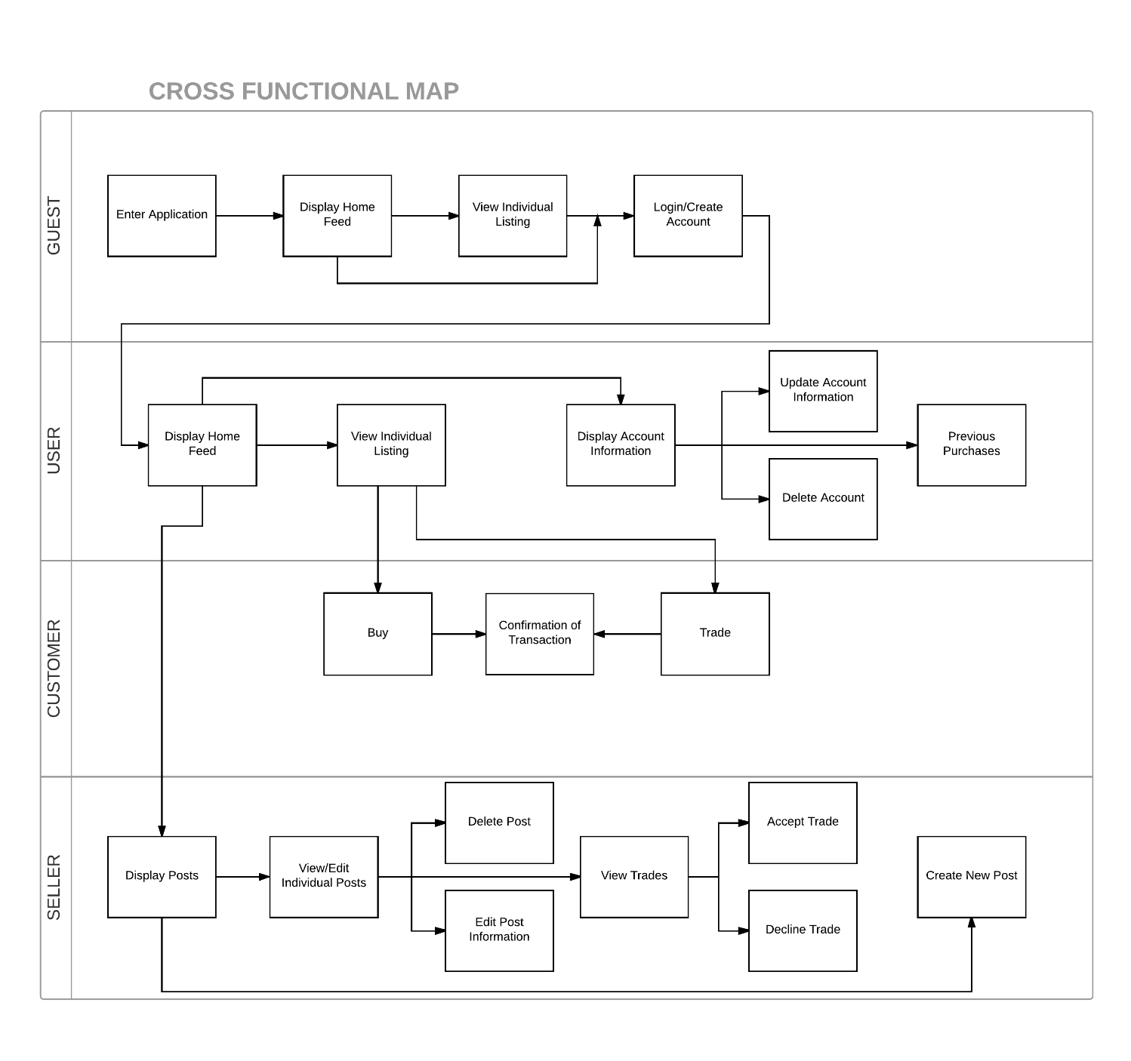
Notes:
BRANDON

Slide 36
Logical Data Model
Notes:
Tim

Slide 37
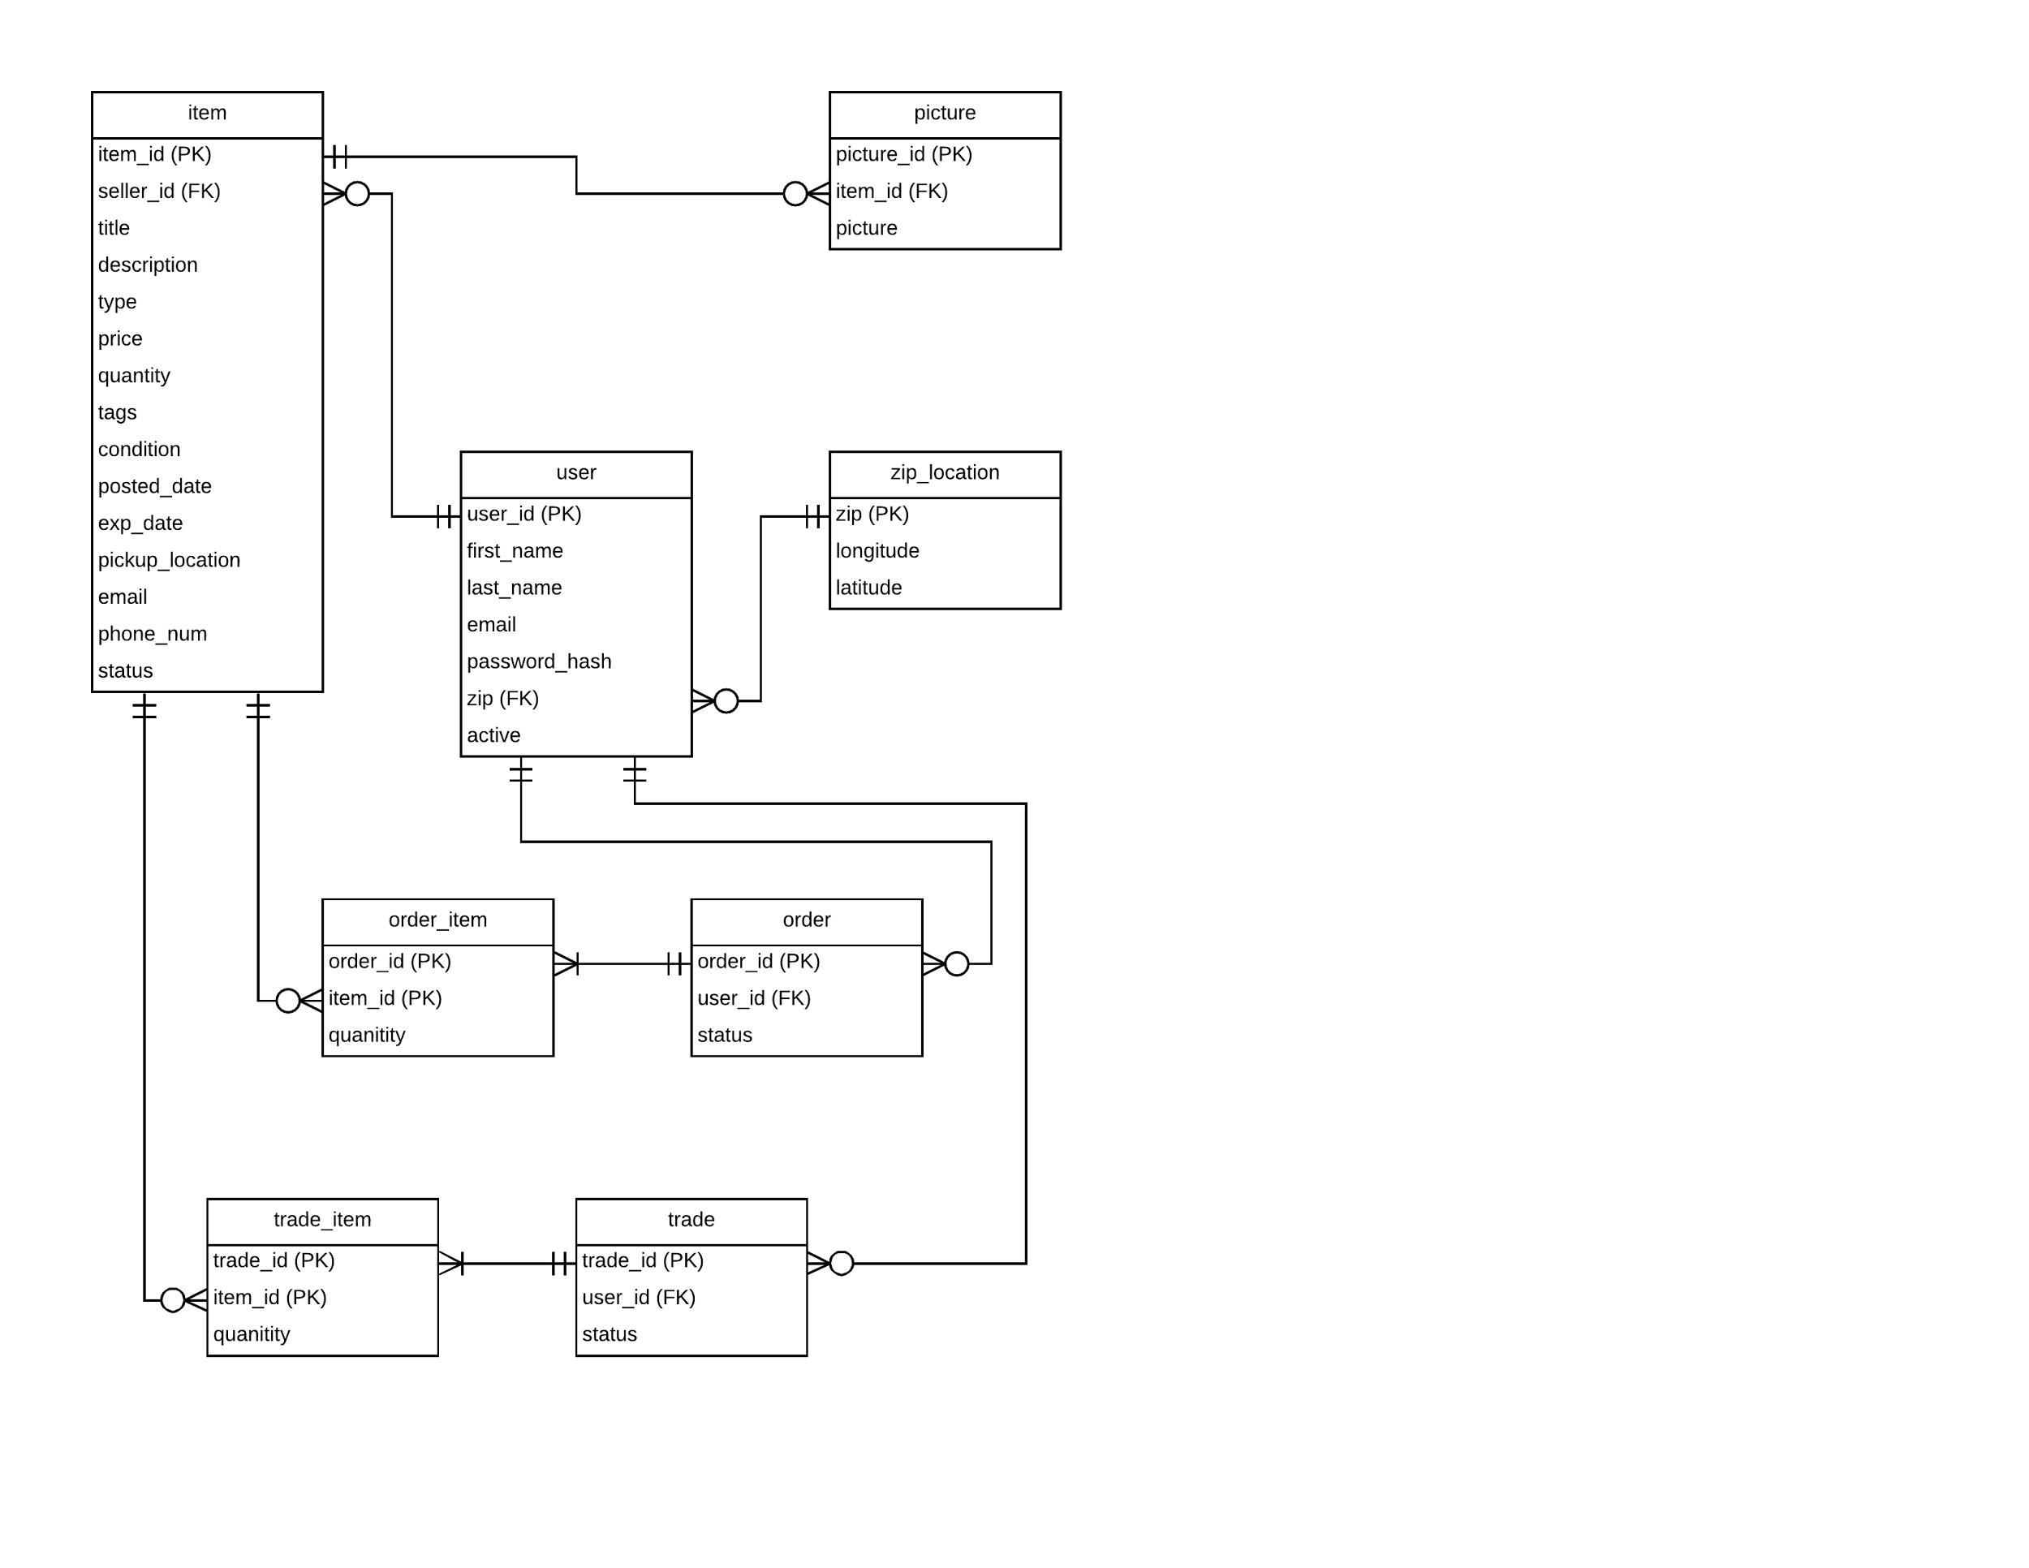
Notes:
Tim
user -zip
item
order -order_item
trade -trade_item

Slide 38
Logical Process Models
Notes:
Tim

Slide 39
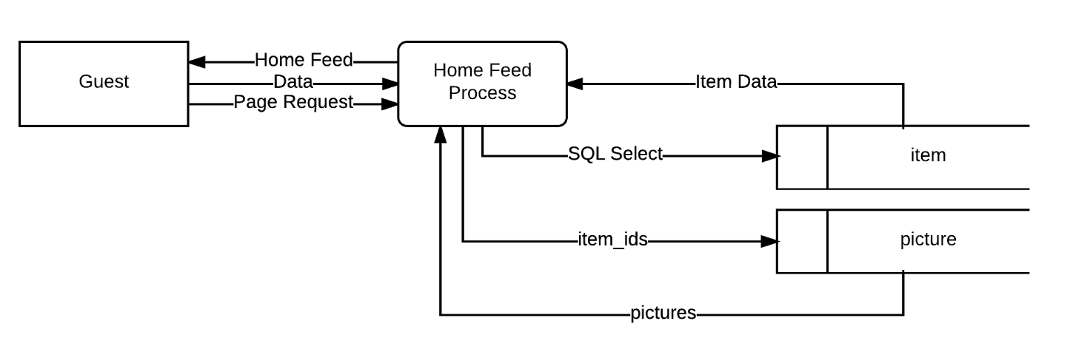
Entering the App
#Enter App
Request Home Feed
Get items within distance
Get item pictures
Generate page
Return page
Notes:
Tim
Entering App

Slide 40

Changing Distance
#Changing Distance
Get new distance
Generate Home Feed
Return Home Feed
Notes:
Tim
Changing Distance

Slide 41
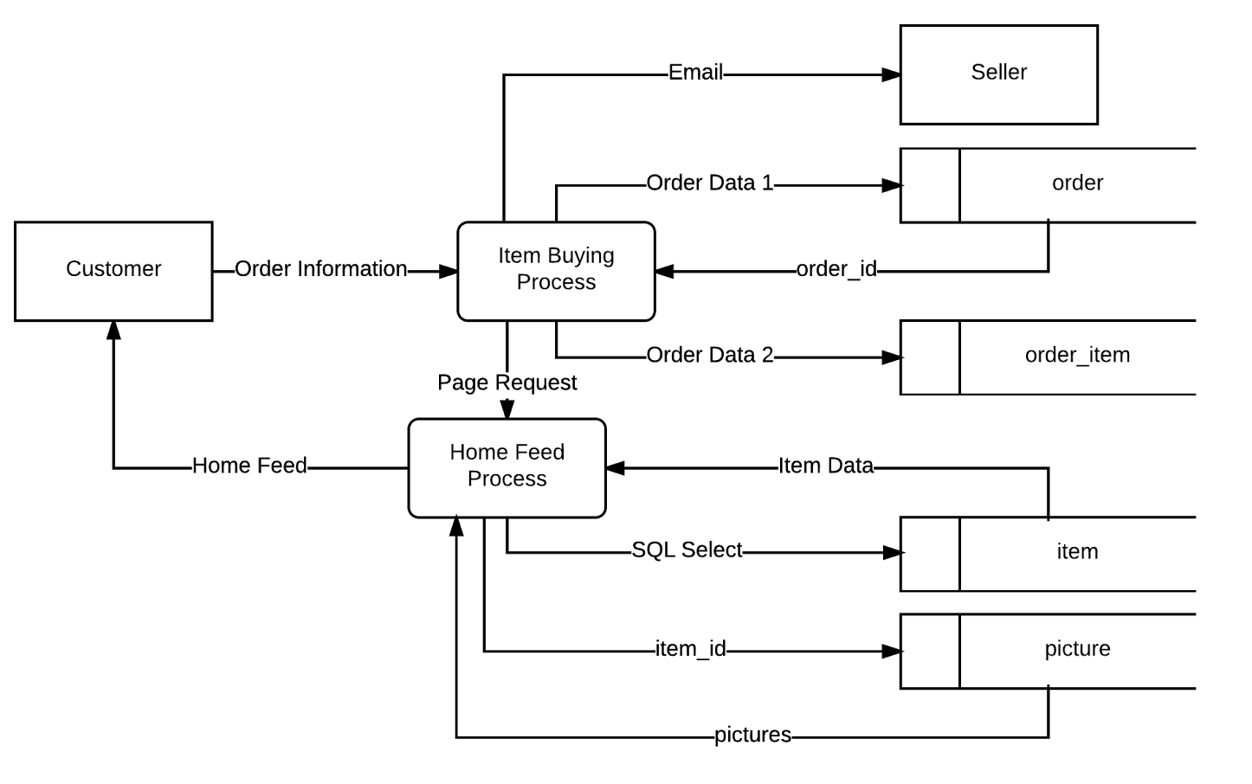
Buying an Item
#Buying
Get order info
Create new order in order table
Get new order_id
Create associations of items to new order in order_item table
Email the seller of the item
Generate Home Feed
Return Home Feed
Notes:
Tim
Buying

Slide 42

Viewing Item Information
#Item Page
Get item_id
Get item data from item table using item_id
Generate Item Page
Return Item Page
Notes:
Tim
Item Information Page

Slide 43

Offering a Trade
#Setting Up a Trade
Get trade info
Create new trade in trade table
Get new trade_id
Create associations of items to new trade in trade_item table
Email the seller of the item
Generate Item Page
Return Item Page
Notes:
Tim
Offering trade

Slide 44
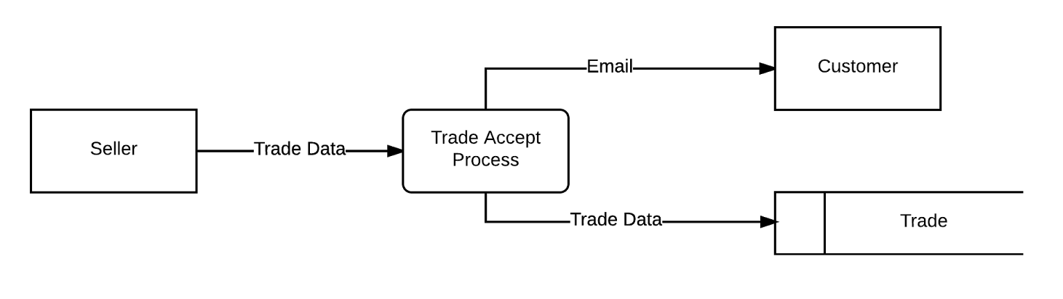
Accepting a Trade
#Accepting Trades
Get trade data
Change status of trade in trade table
Email trading customer
Notes:
Tim
Accepting trade

Slide 45
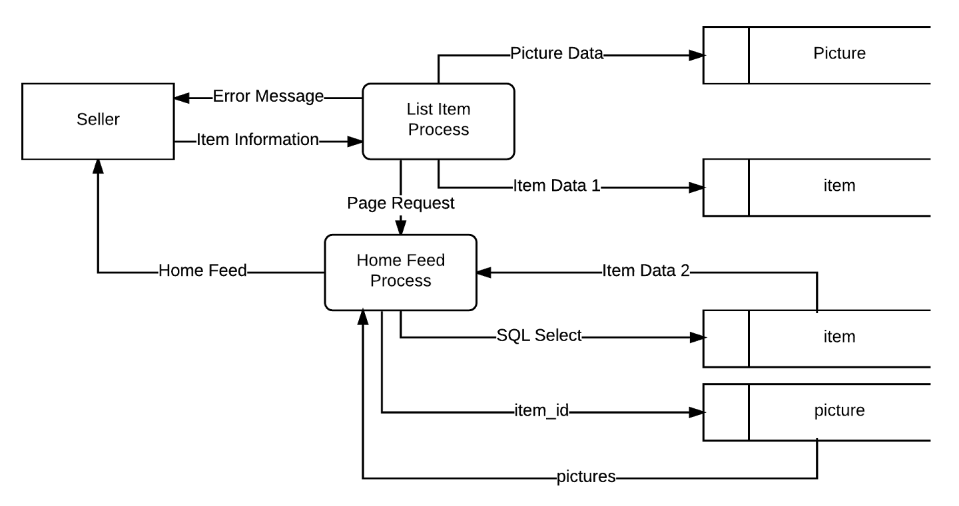
Listing an item
#New Listing
Get item info
if(info is valid):
Add new item to item table
Add item pictures to picture table
Generate Home Feed
Return Home Feed
else:
Return error message
Request valid information
Notes:
Tim
Listing item

Slide 46
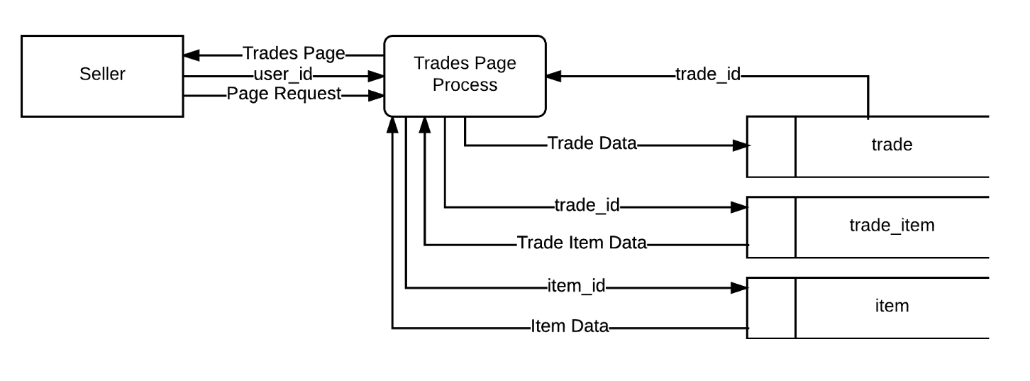
Viewing Trade Offers
#Trade Offers Page
Get user_id
Get trade_ids for user_id from trade table
Get item_ids associated with trades from trade_item
Get item data of item_ids
Generate Trade Offers Page
Return Trade Offers Page
Notes:
Tim
Trade Offers Page

Slide 47
User Experience Diagram
Notes:
Brandon

Slide 48
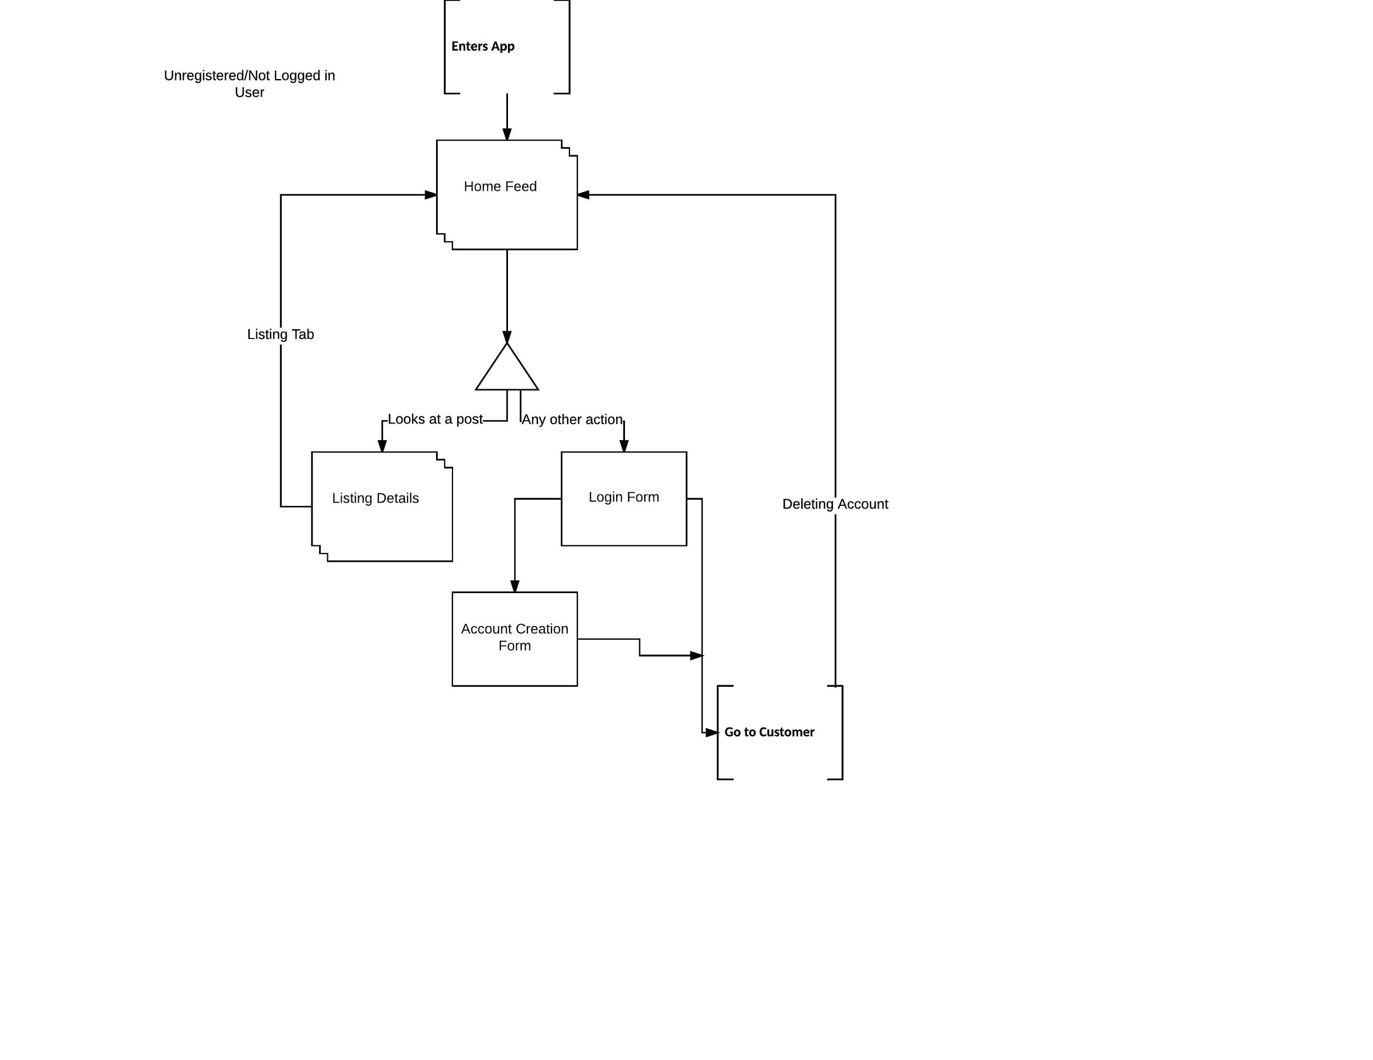
Notes:
Brandon

Slide 49
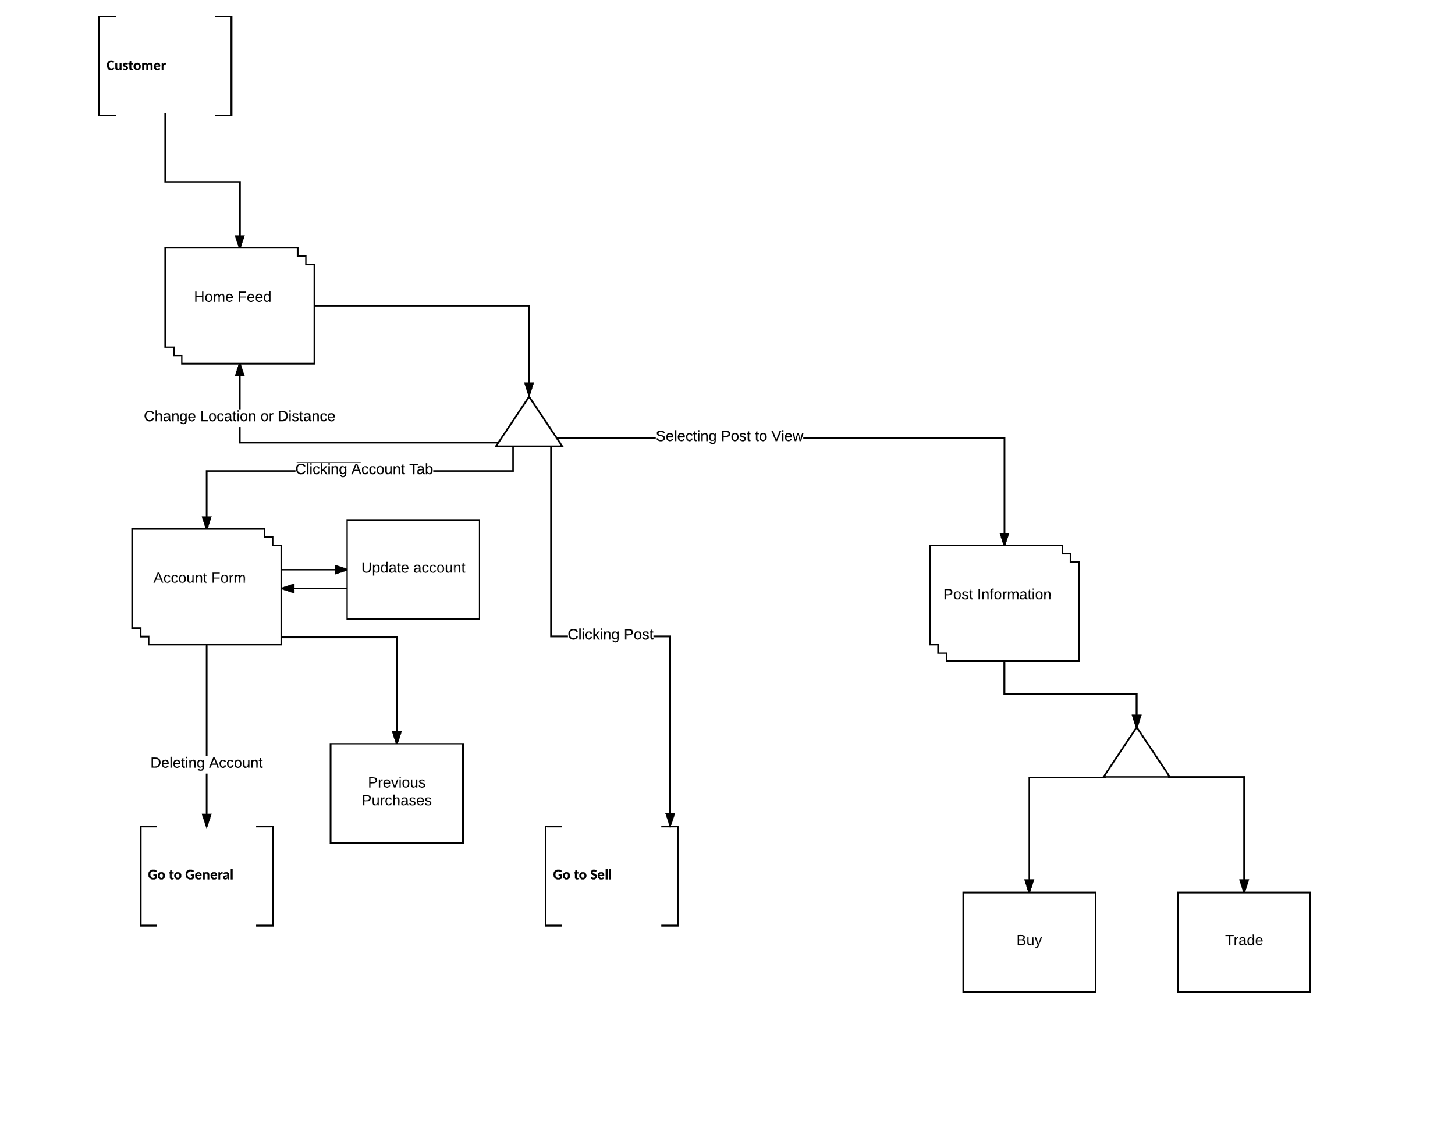
Notes:
Brandon

Slide 50
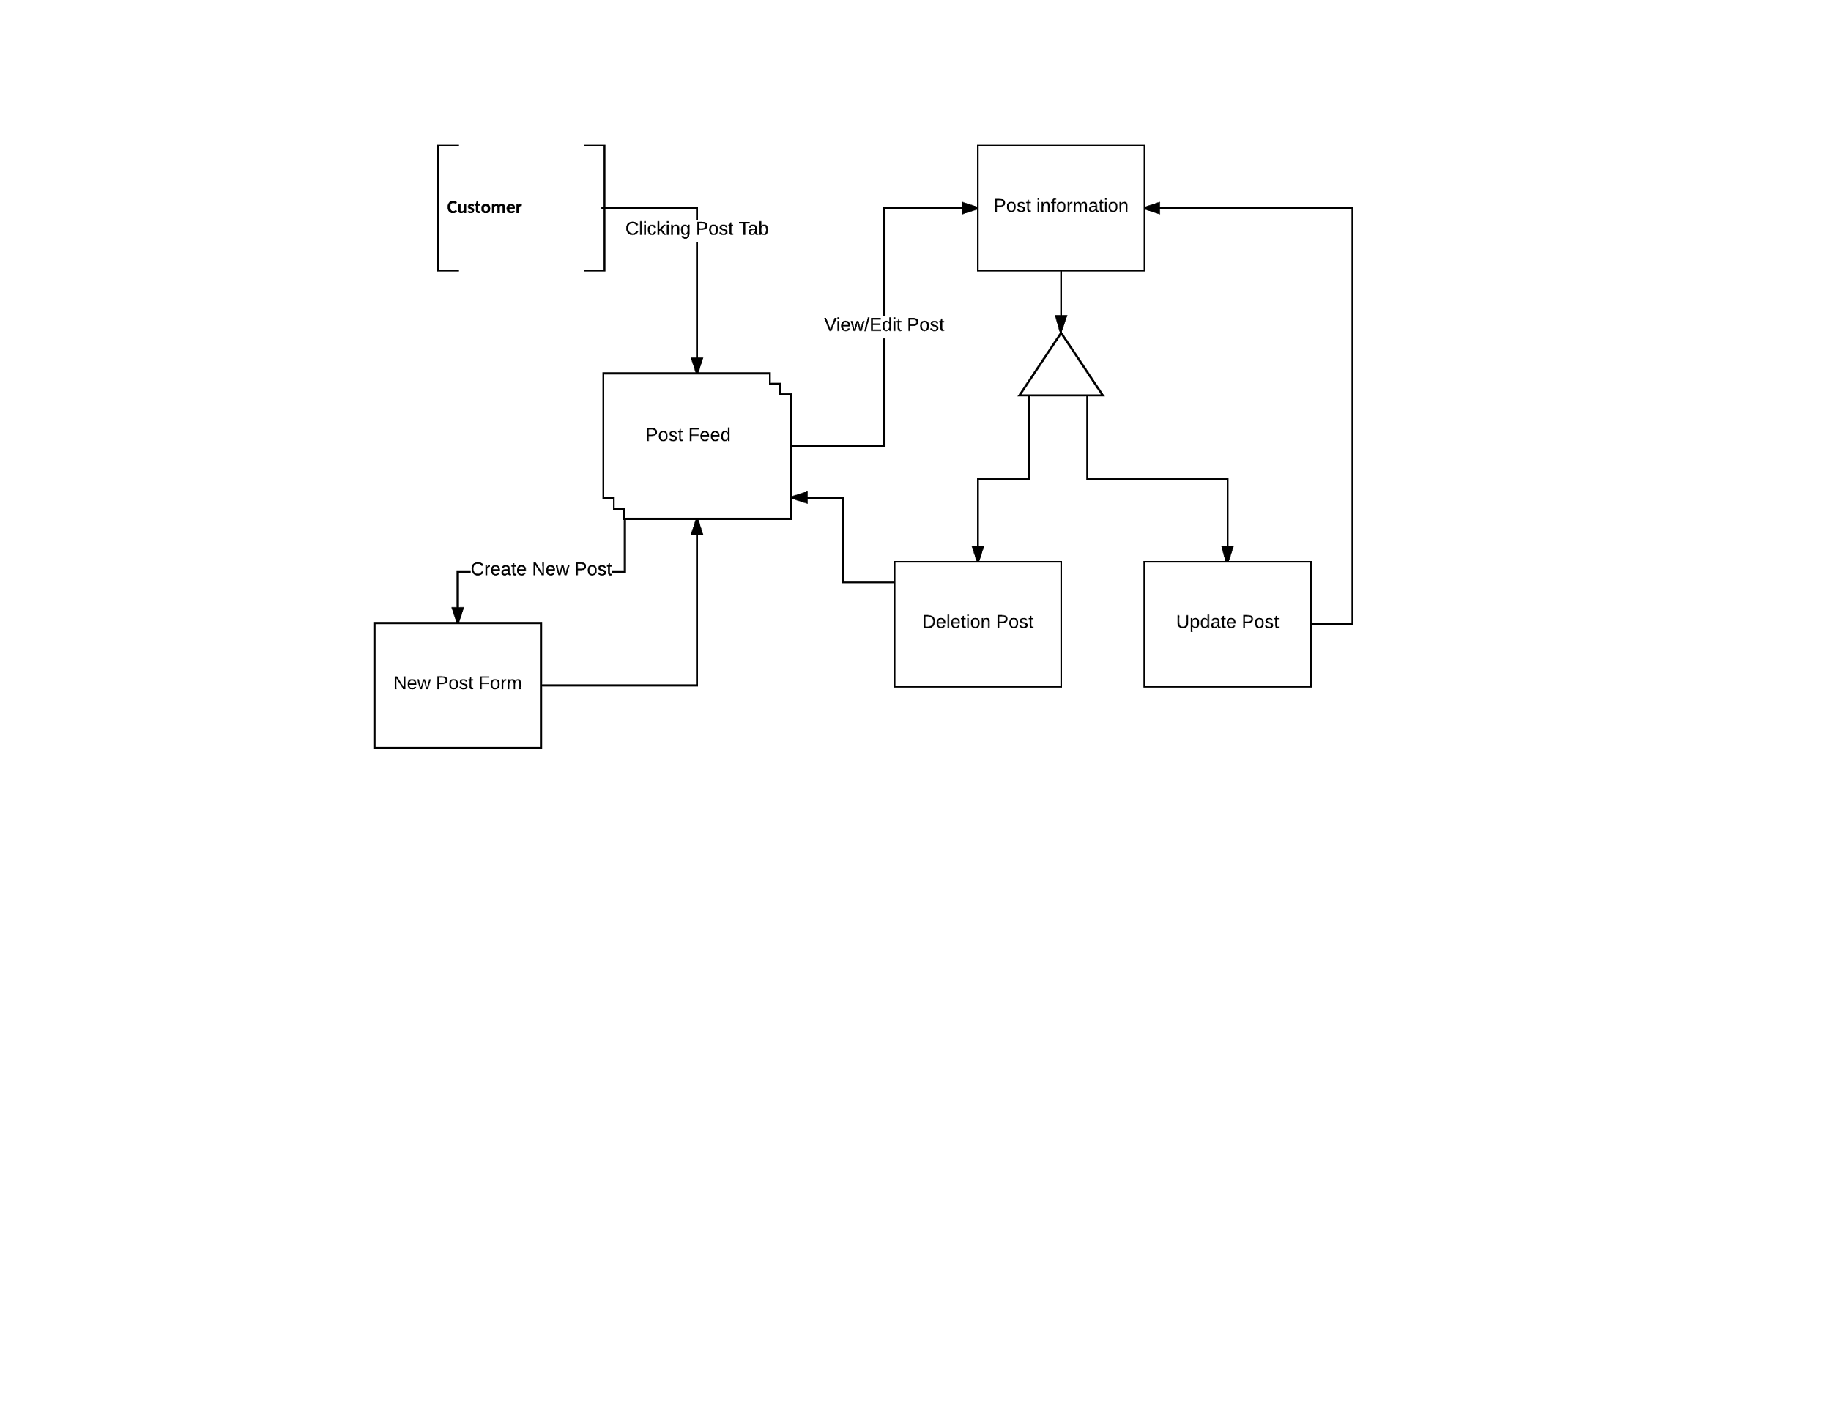
Notes:
Brandon

Slide 51
Wireframes
Notes:
Adam

Slide 52
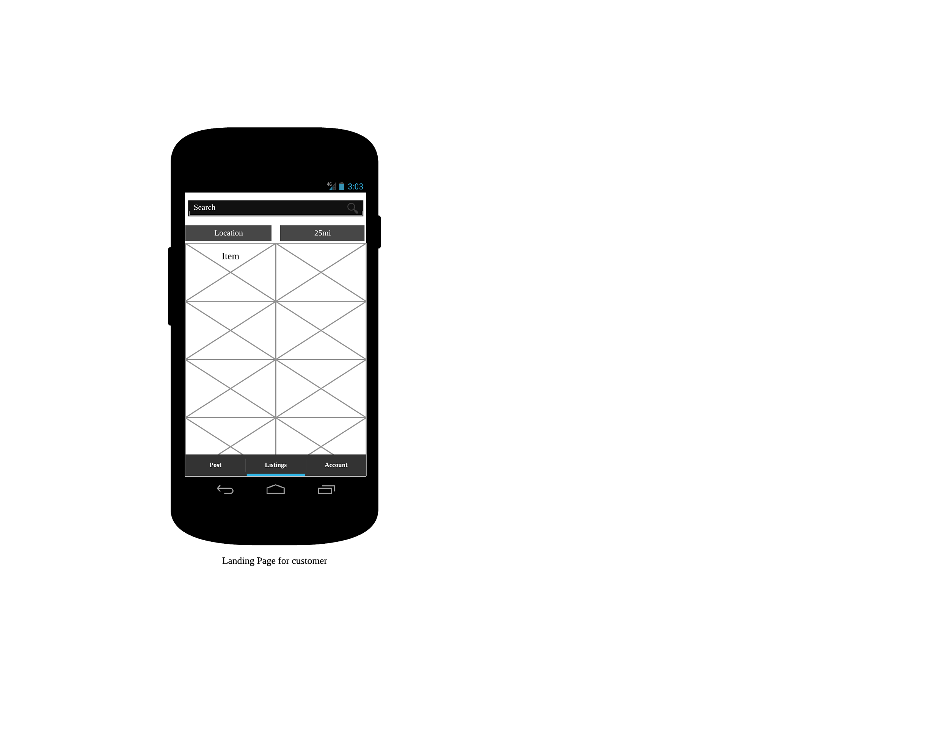
Notes:
Adam

Slide 53
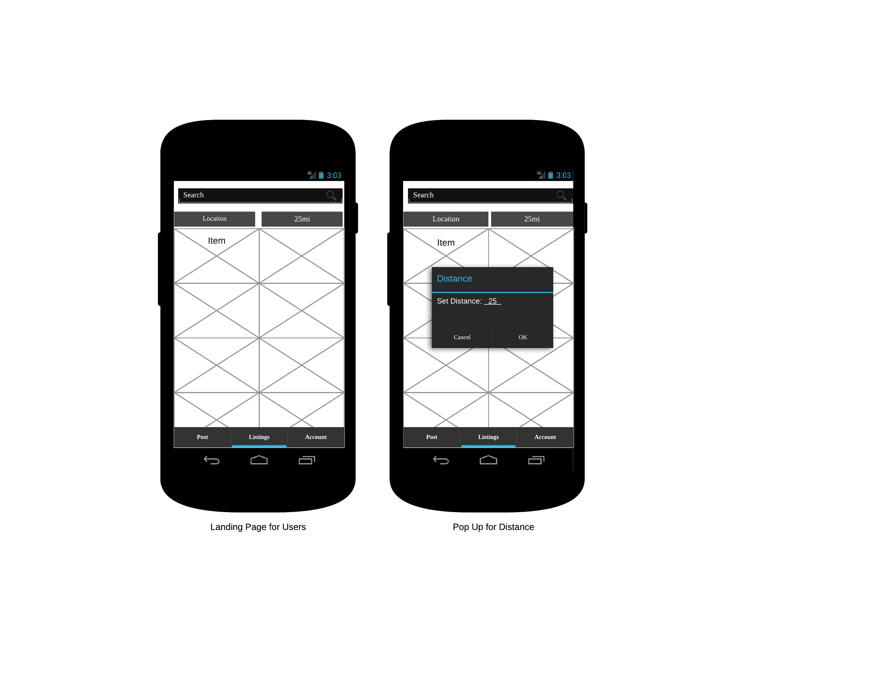
Notes:
Adam

Slide 54
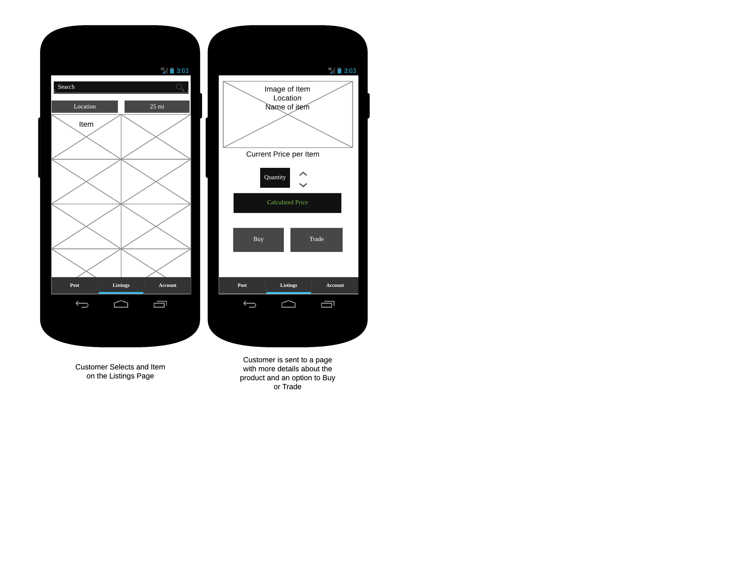
Notes:
Mitch

Slide 55
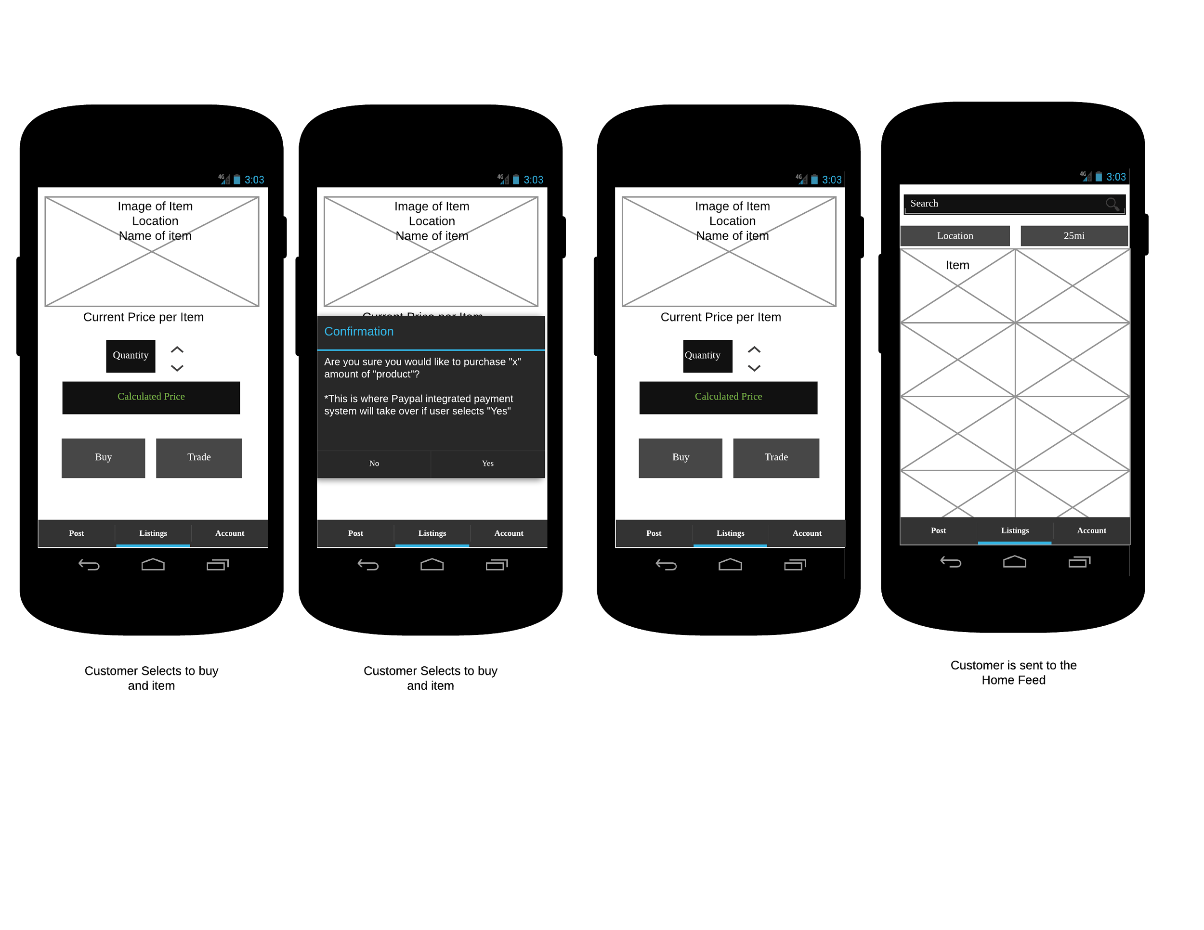
Notes:
Mitch

Slide 56
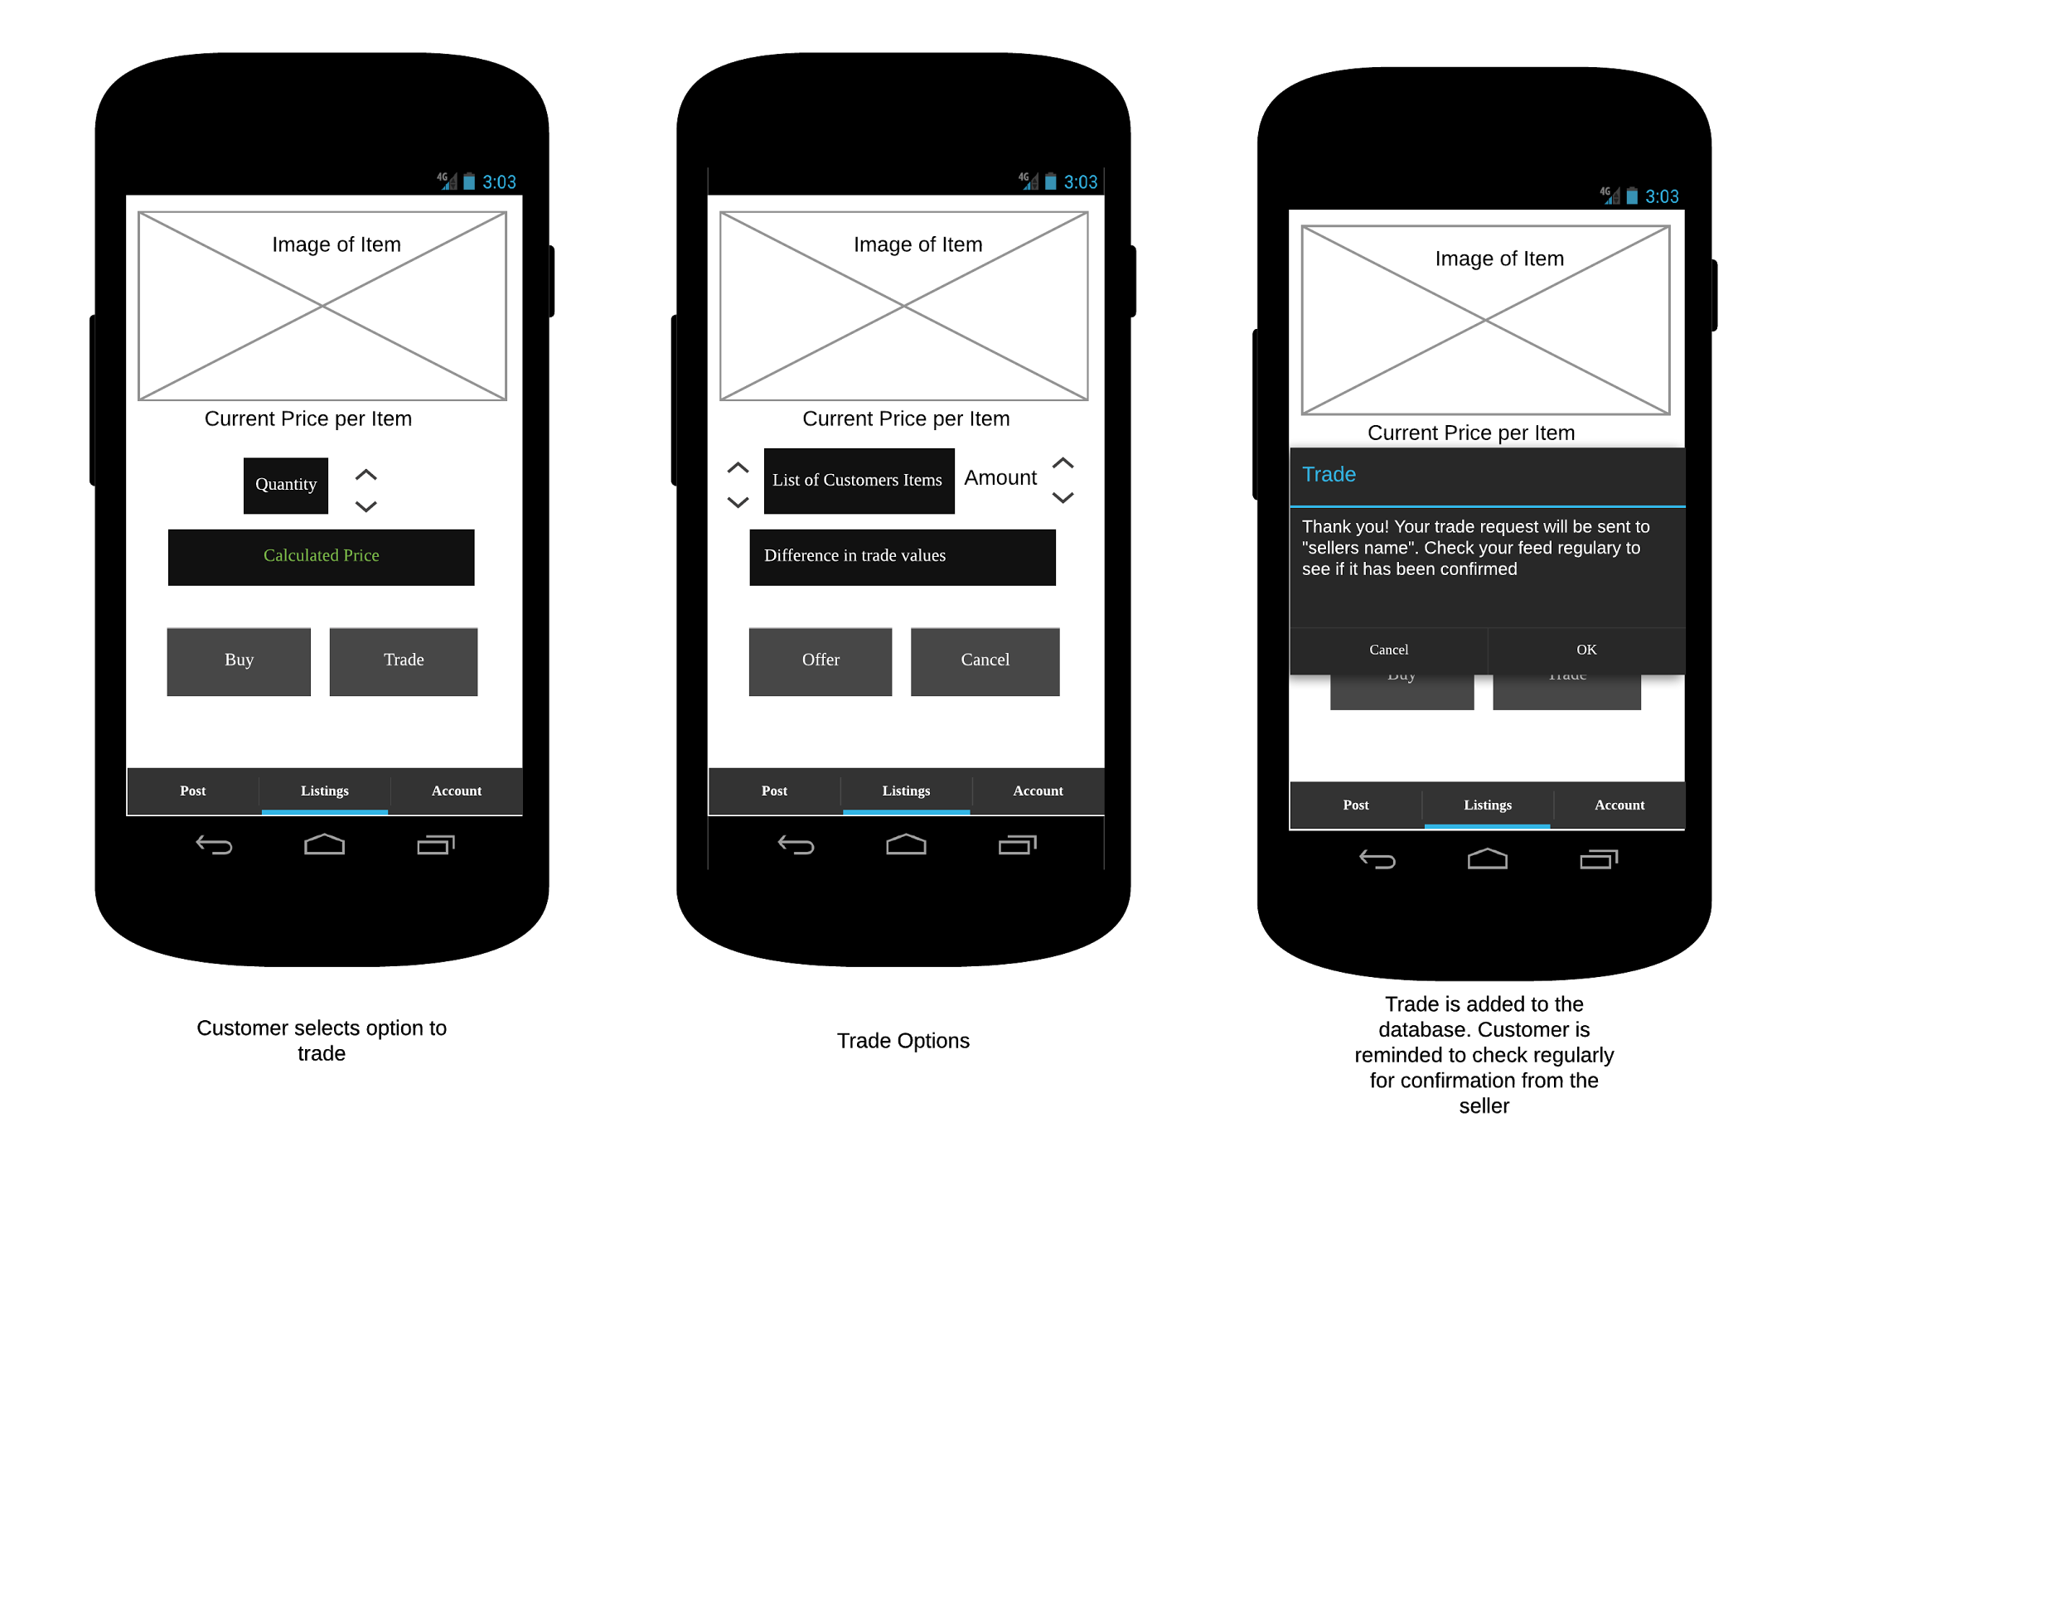
Notes:
Adam

Slide 57
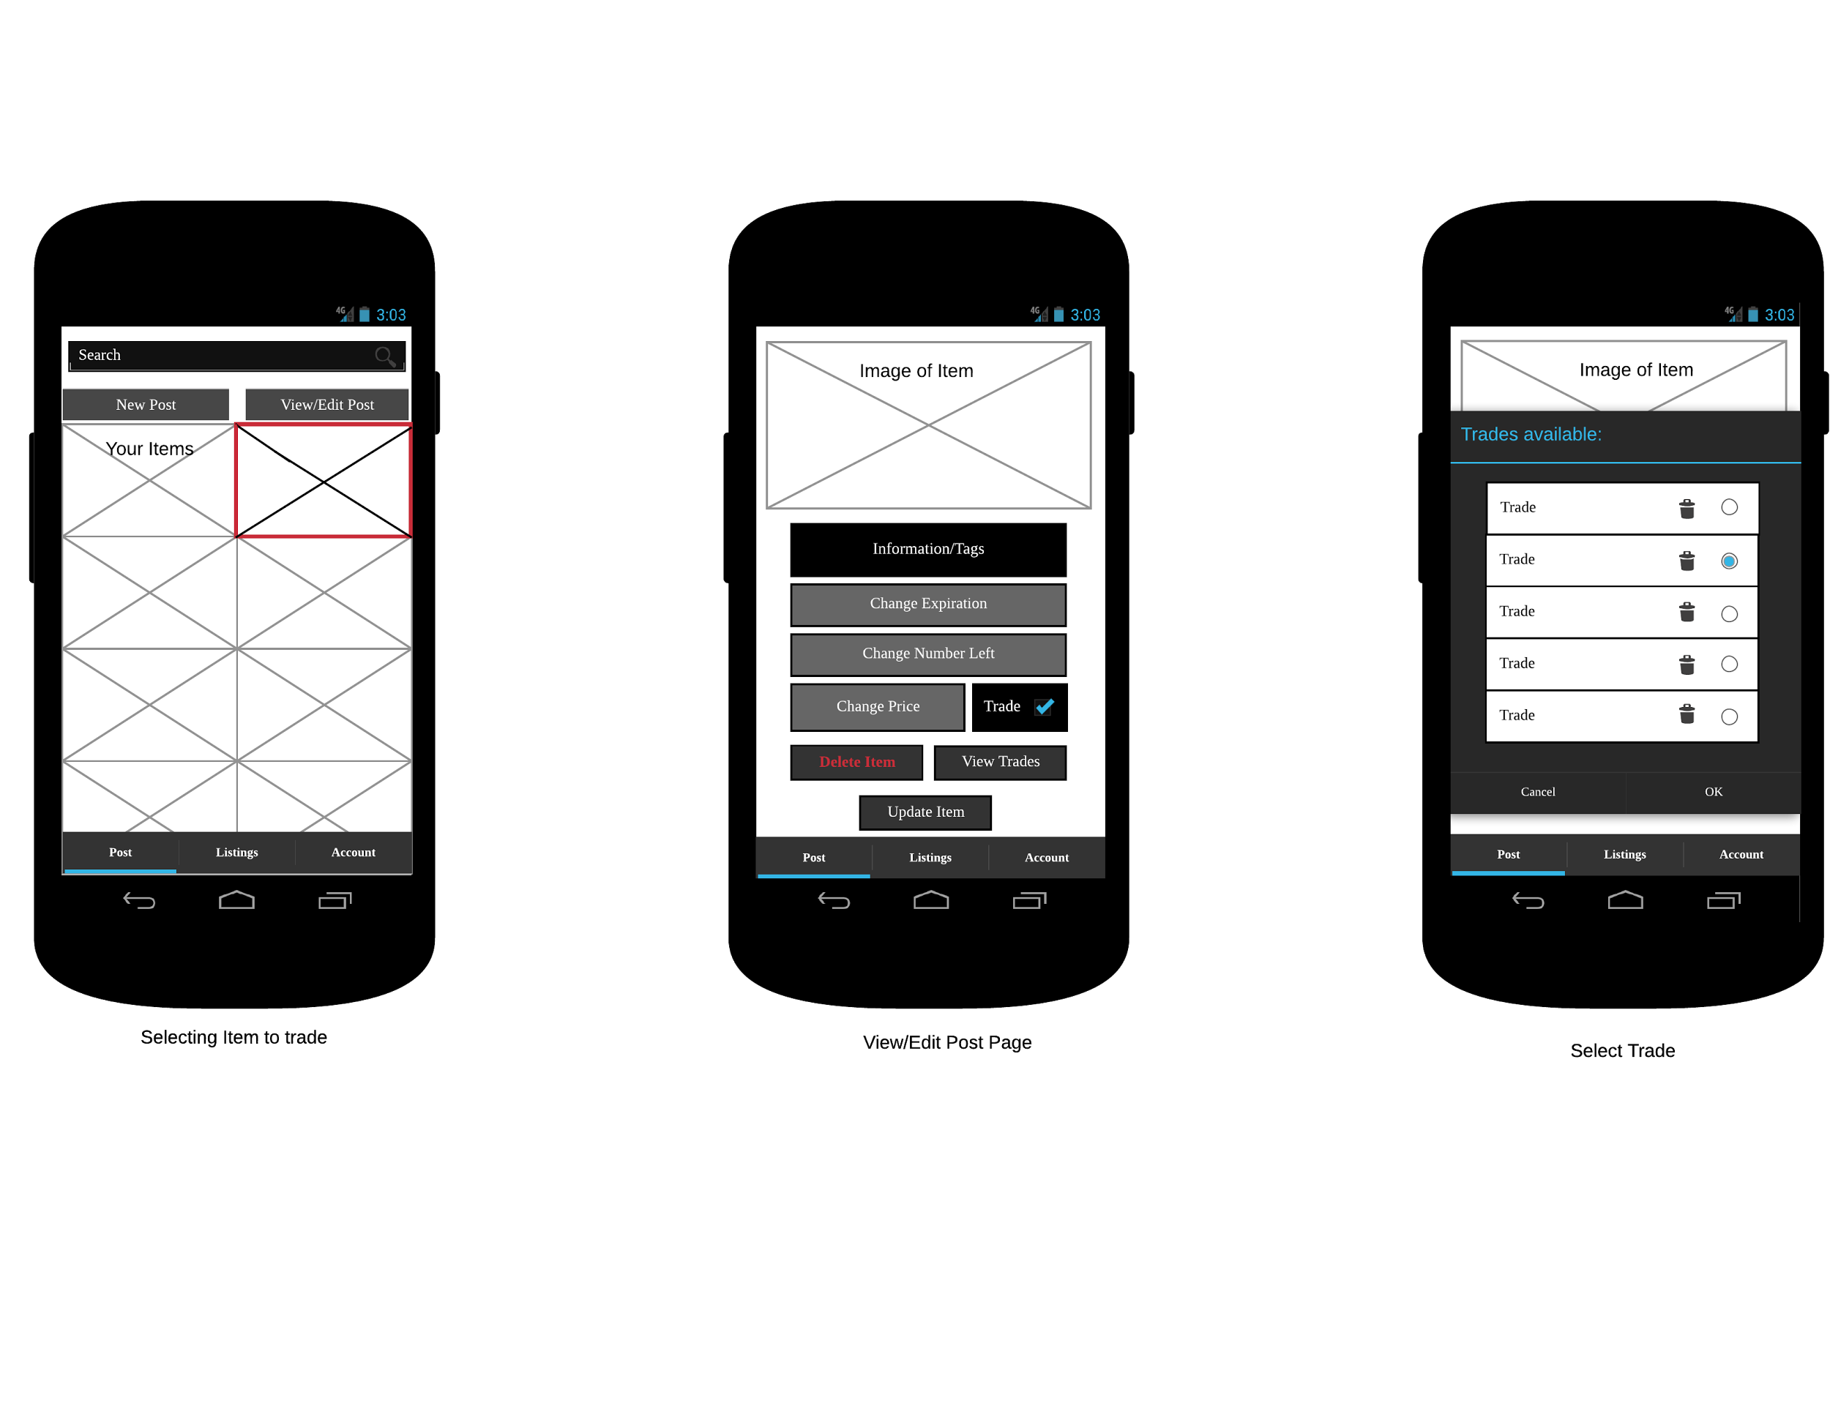
Notes:
Adam

Slide 58
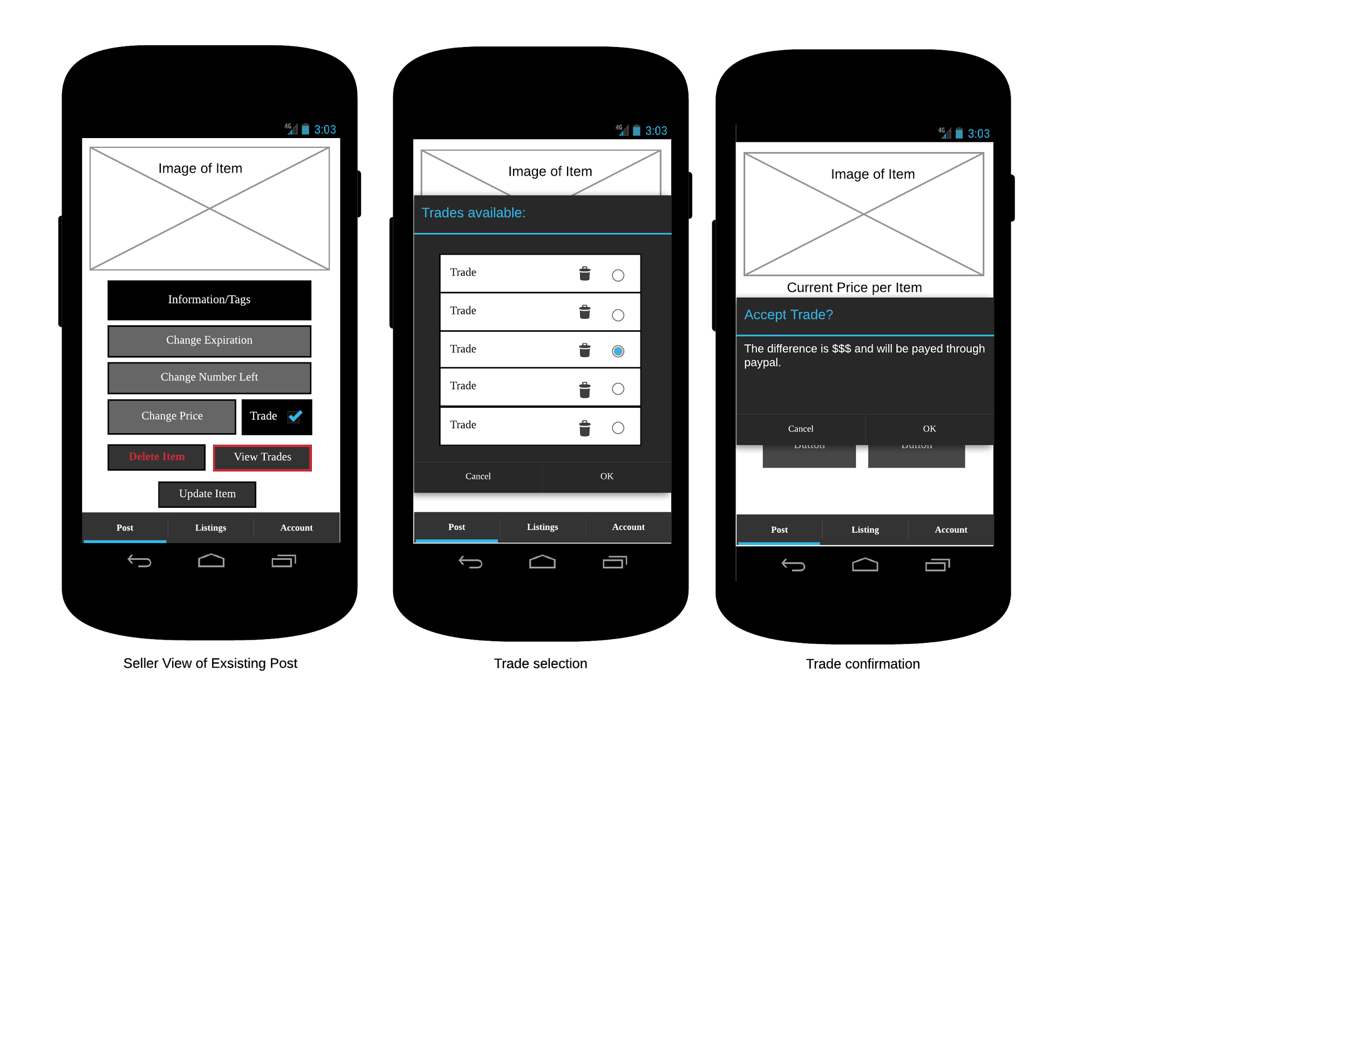
Notes:
Adam

Slide 59
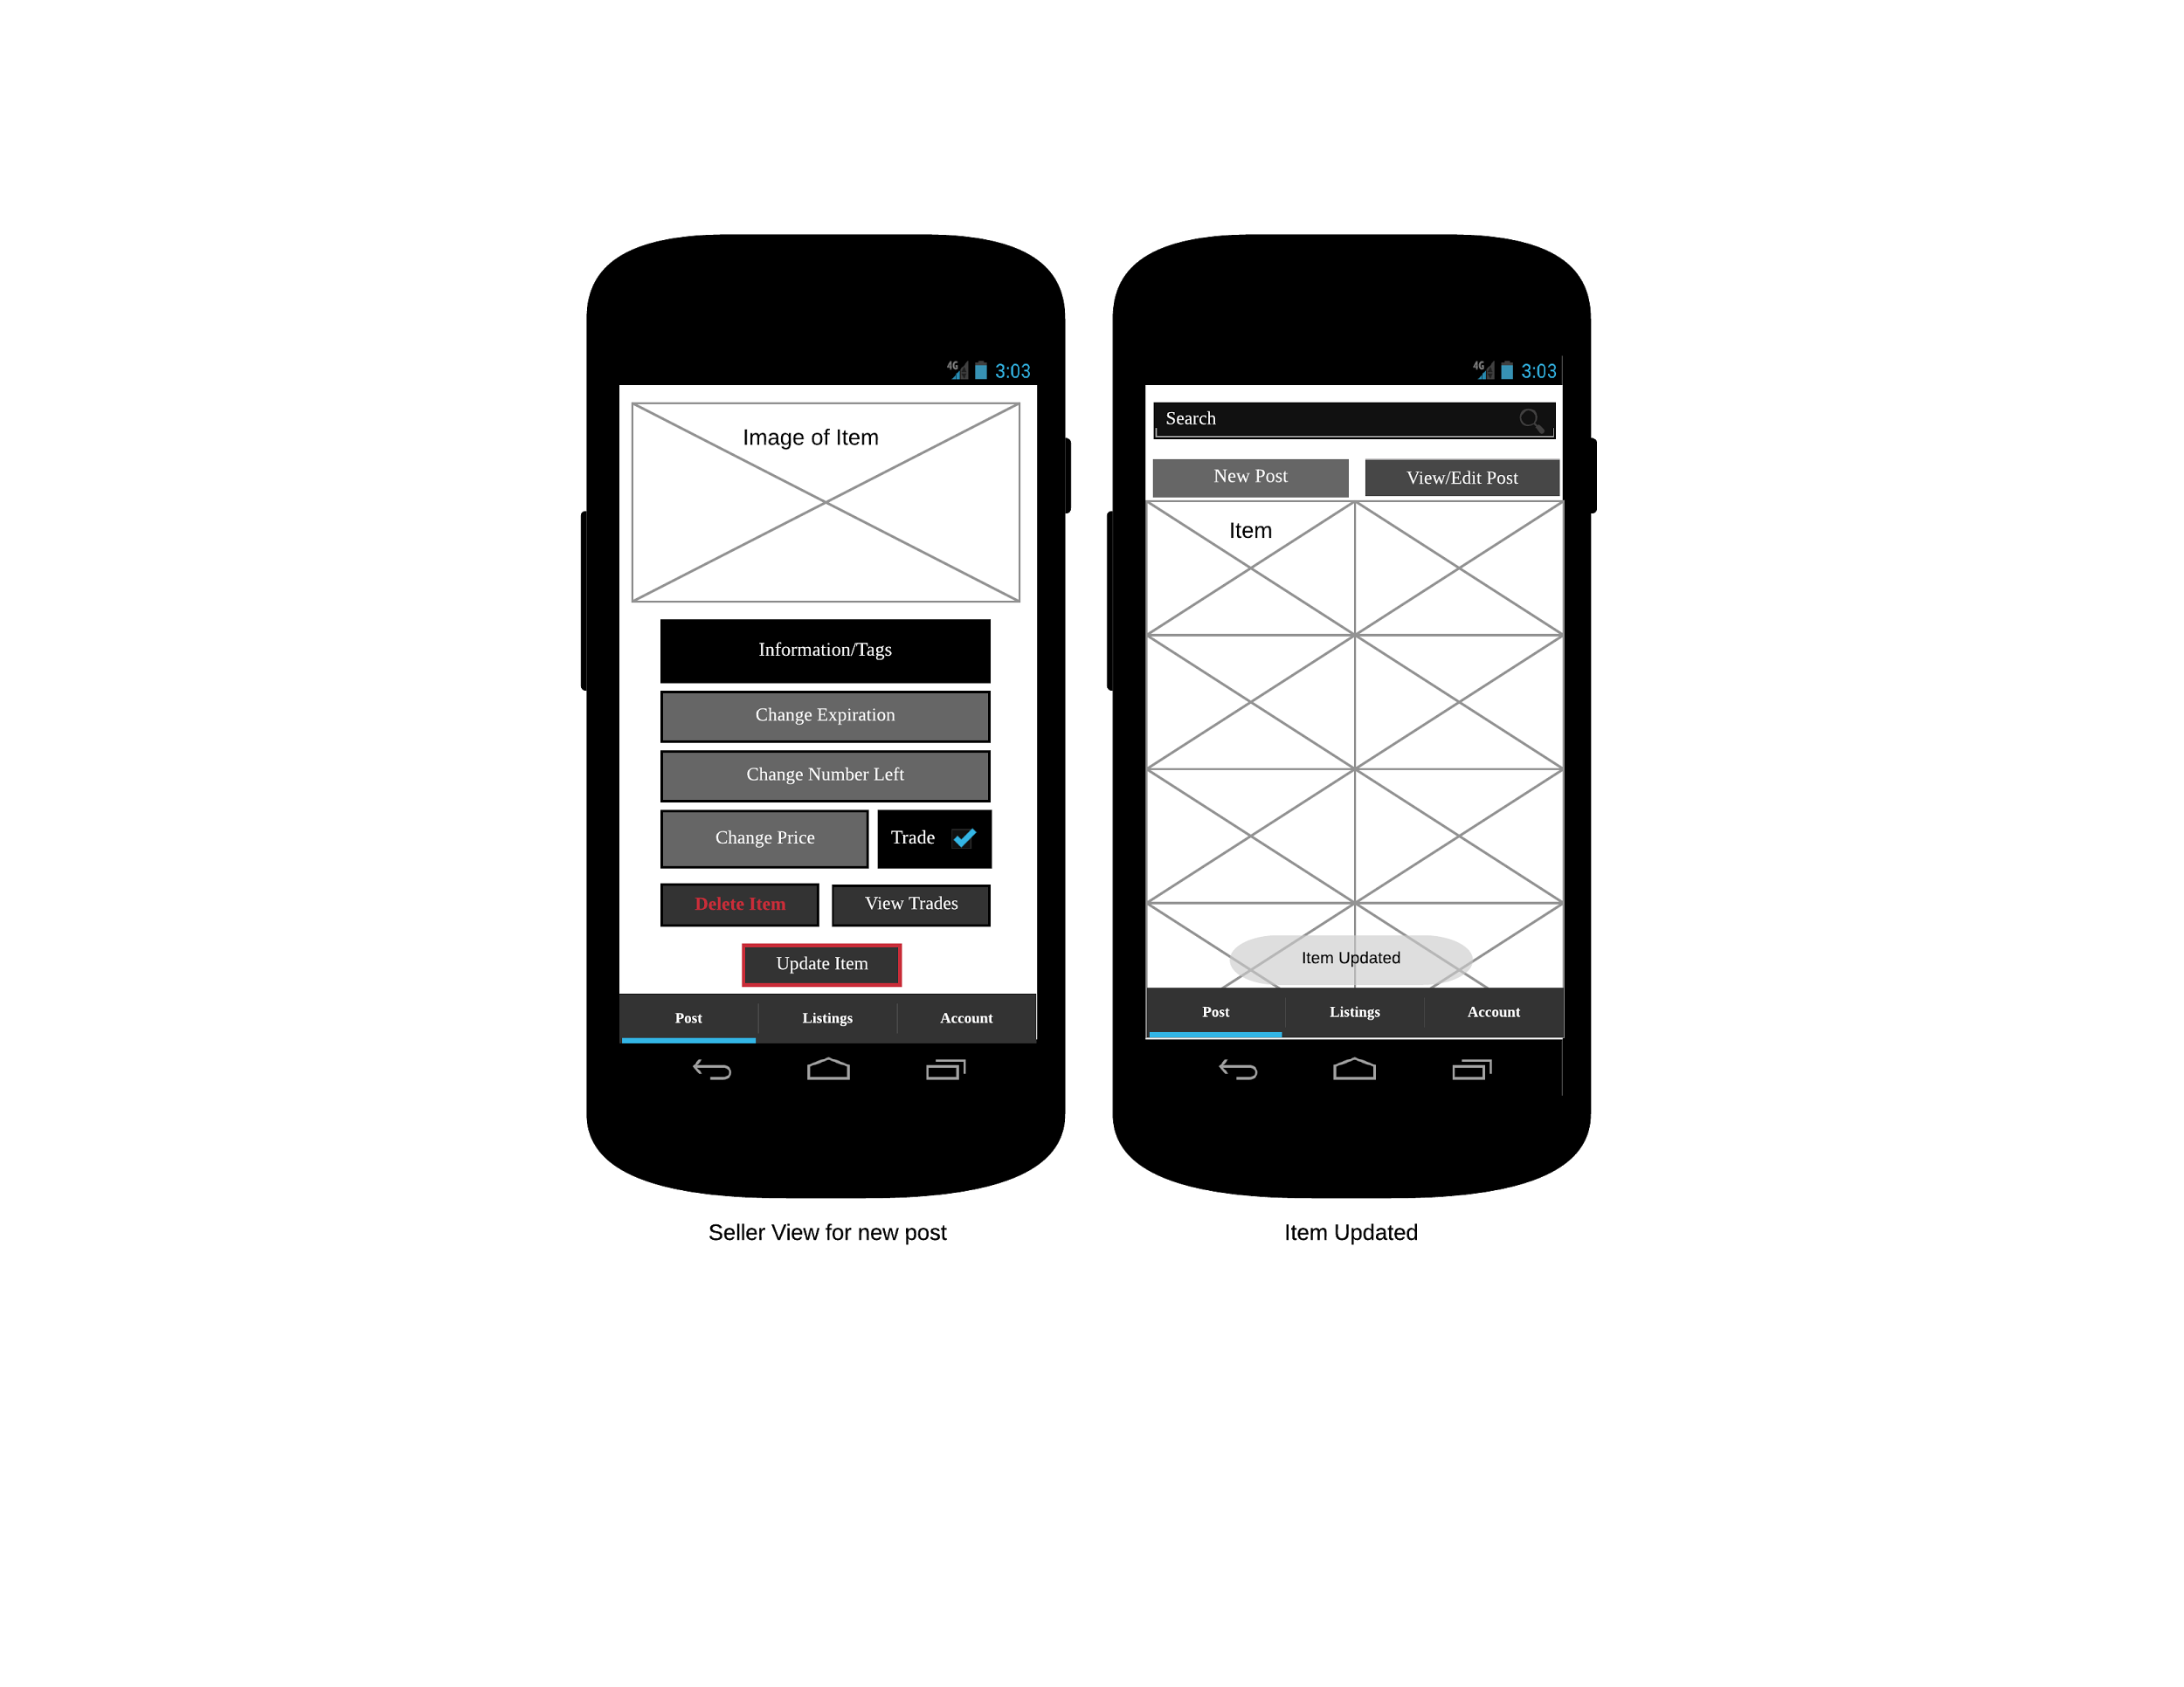
Notes:
Mitch

Slide 60
Non-Functional User Requirements
Notes:
Chris

Slide 61
Usability
Buy items from other users
Users can sell items on the app
Simple trading
Easy browsing for unregistered users
Notes:
Chris

Slide 62
Accessibility
English language
Usable for ‘non-technical“ users
User friendly to colorblind users
Notes:
Noah

Slide 63
Availability
Available at all times
Notification emails sent if system is down
Page Error alerts
Notes:
Noah

Slide 64
Documentation and Training
Basic user manual
Minimal training for the average user
Database administrator
Notes:
Noah

Slide 65
Non-Functional System Requirements
Notes:
Mitch

Slide 66
Performance
Not intended to use a large amount of resources
Not sluggish or slow
Little battery life usage
Notes:
Mitch

Slide 67
Capacity
Small server to start with
5GB standard storage
Limited GET and PUT requests
Future upgradability
Notes:
Brandon

Slide 68
Security
User must be logged in to do certain tasks
Limited session timers
Secure passwords
SQL sanitization
Notes:
Tim
Access Control
Limited sessions
Passwords stored as hash and length
SQL injection protection

Slide 69
Longevity
Continue growing in the local area, hopefully much larger
Limited by small budget and server prices
Notes:
Mitch

Slide 70
Conclusion
Custom Build - Gardener's Exchange
Meets all customer requirements
Notes:
Mitch

Slide 71
Notes:
Open questions

